Slide 1

STATUS REPORT: DIH SUMMER PROJECT
Probabilistic Approach Based Anomaly Detection Techniques for Real Time Systems
Prepared by:
Shikhar Gupta [15035040]
Rahul Meena [16084012]
Harshit Mishra [16155031]
Supervised by:
Dr. Hari Prabhat Gupta
Dept. of Computer Science

Slide 2
Problem Statement :
In a data-driven culture, companies approach decision-making from a quantitative point of view and rely less on gut feeling when making major decisions. ... Lack of accurate, timely or relevant data from across the business is also a major concern among companies with primitive or basic capabilities.
In statistics, an outlier is an observation point that is distant from other observations. ... An outlier can cause serious problems in statistical analyses. Outliers can occur by chance in any distribution, but they often indicate either measurement error or that the population has a heavy-tailed distribution.

Slide 3
Anomaly Detection problems
Anomaly detection is applicable in a variety of domains, such as intrusion detection, fraud detection, fault detection, system health monitoring, event detection in sensor networks, and detecting ecosystem disturbances. It is often used in preprocessing to remove anomalous data from the dataset. In supervised learning, removing the anomalous data from the dataset often results in a statistically significant increase in accuracy.

Slide 4
Dataset : Single Chest-Mounted Accelerometer Dataset
Data Set Information:
The dataset collects data from a wearable accelerometer mounted on the chest
Sampling frequency of the accelerometer: 52 Hz
Accelerometer Data are Uncalibrated
User Activity: Walking
Data Format: CSV
Training Instance = 25000
Attribute Information:
sequential number, x acceleration, y acceleration, z acceleration
Data Statistics:
x-axis y-axis z-axis
count 25000.000000 25000.00000 25000.00000
mean 1884.735640 2380.74432 2052.27404
Std 45.984328 88.14063 48.85544
min 1704.000000 2179.00000 1878.00000
25% 1859.000000 2315.00000 2019.00000
50% 1886.000000 2364.00000 2043.00000
75% 1908.000000 2433.00000 2085.00000
max 2110.000000 2678.00000 2248.00000

Slide 5
Our approach:
We are using linear regression technique for anomaly detection in real time system data. linear regression is a linear approach to modelling the relationship between a scalar response (or dependent variable) and one or more explanatory variables (or independent variables). The case of one explanatory variable is called simple linear regression.

Slide 6
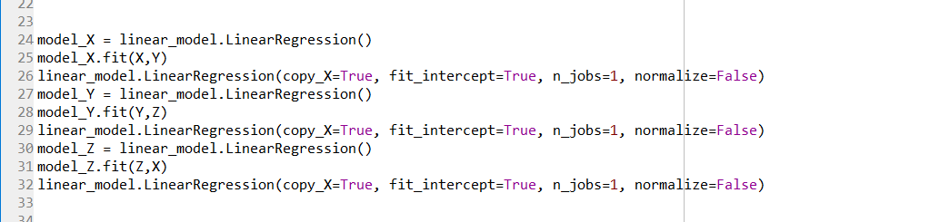
Implementation:
Importing Libraries :- numpy,matplotlip,pandas, sklearn, linear model
Training data loading
Attribute :- x,y,z
25000 intense
Test data loading
Attribute :- x,y,z
100 intense
Continue...

Slide 7
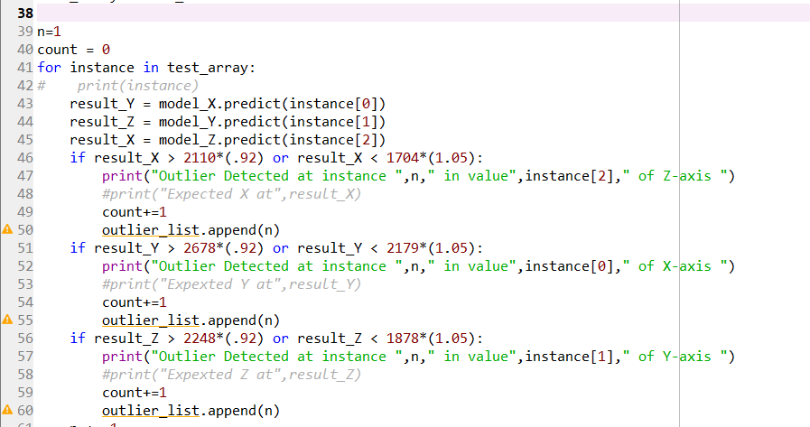
Plotting – 3D graph with X,Y,Z attribute loading of both training and testing data

Slide 8
Training data insight:
Testing data insight:

Slide 9
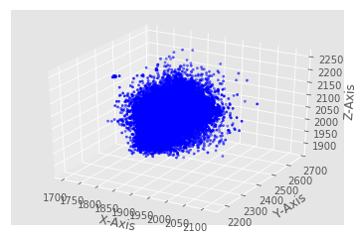
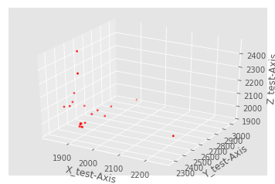

Slide 10

Thank you

